Slide 1
Policy Memo Development
You’re an expert policy analyst, and a client has asked for your help.
Your client has a problem, and they’re expecting you to have the skills and expertise to solve that problem for them.
Your client wants your solution to the problem in the form of a policy memo because they don’t have time to read anything longer.

Slide 2
Policy Memo Format
To:
From:
Date:
RE:
Executive Summary
Background and Methodology
Key Findings
Recommendations
Conclusion

Slide 3
Three Policy Memo Types
Start by massive information reviews and performing calculations? NO!
A better way to begin is to ask yourself what the client doesn’t yet know.
More specifically, what is it they need to know to fulfill their mission or achieve their goals?
Three questions the client could be struggling with and policy answer types:
What is happening? What is working? What should be done next?
Descriptive Evaluative Prescriptive

Slide 4
Four Elements of a Policy Answer
The next step is to determine which pieces of evidence you’ll need to make each type of policy answer as persuasive as possible.
In public policy, you can divide evidence into four distinct types:
Condition What’s happening?
Criteria What should be happening?
Cause Why is the condition happening? [i.e., Correlation/Contributing Factors]
Effect What might happen next?

Slide 5
Executive Summary
Writing deductively, always start by stating your main point (recommendation) first!
The remaining sentences in the paragraph should present the data, facts, statistics, as well as your analysis and reasoning (and any context needed) to prove the point you make in the first sentence.
Then briefly summarize your main findings as answers to your client’s questions. Essentially, you are explaining why you are recommending they take-action. End the summary with a brief statement of what will happen if the client implements your recommendation.

Slide 6
Background and Methodology
Here you will provide context and any historical or technical information the reader may need to understand your findings—and nothing more. Consider what your reader already knows. You may also need to briefly explain where your data comes from and how they were analyzed. Depending on your findings, you may not even need a Background & Methodology section.

Slide 7
Key Finding(s)
In the key finding section(s), you will answer your client’s questions directly. You will also provide evidence (and the context surrounding the evidence), as well as your analysis of the evidence in support of your descriptive, evaluative, or prescriptive answer. You may also need to include information on any limitations associated with your findings and rebut alternative options, if necessary.

Slide 8
Recommendations
Your recommendations should link the root causes of the requestor’s problem, which you should have identified in your key findings section, with what needs to be done by whom. Your recommendations should be feasible, cost effective, and specific without being too narrow.

Slide 9
Conclusion
Your conclusion should place your key findings in a broader context that reminds the reader of the issue’s importance. Why is important that action be taken immediately? A good conclusion will weigh loss aversion against hope for the future as motivating factors.

Slide 10
Writing Recommendations That Matter 1
To be most effective, recommendations to improve operations or conduct further research should (1) clearly identify feasible actions that need to be taken and (2) provide the appropriate level of detail to facilitate implementation and subsequent follow up. Other considerations include:

Slide 11
Writing Recommendations That Matter 2
Audience: Address your recommendation to a person or program so that it’s clear who’s responsible for ensuring the recommendation is implemented.
Purpose: To be valuable to your client, your recommendations must:
Explicitly connect to the description of the evidence.
Evaluate between the cause of whatever barriers or challenges are holding the
client back vs. the potential outcome you would expect to arise from the
recommendation.
Be feasible, cost-effective, and measurable.
Explanatory Statement: Focus on concisely presenting who should do what and why. Avoid phrasing that reintroduces the barriers or challenges you uncovered. That information should be presented in the key finding section.

Slide 12
Writing Recommendations That Matter 3
Lead-in Sentence: If you’re making multiple recommendations, use a lead-in sentence like: “We are making four recommendations to improve program operations...” Your recommendations can then be placed into a numbered or bulleted list below the lead-in sentence.
Clarity and Precision: Choose specific phrasing (e.g., explore vs. ensure and plan vs. implement require different actions). Avoid being unnecessarily prescriptive. If you want to recommend that certain steps be taken, those steps should be introduced with including or similar language. If, on the other hand, you want to recommend that your client determine their own course of action to meet your recommendation’s intent, you can introduce those steps with such as or similar language.

Slide 13
Writing Conclusions That Matter
Make it clear to your reader why it is important for them to act on your policy recommendations now. What is the lasting message you want them to take away?
Purpose: To be valuable to your client, your conclusions must:
Highlight the significance of your key findings.
Explain why corrective action needs to be taken.
Inspire an immediate response.
Tone: Effective conclusions are fair and balanced, proactive, and compelling.
Approach: Highlight outcomes that may follow the enactment of the recommendations: “If you do X, Y will happen,” and Make explicit the stakes of the recommendations.
Things to Avoid: DO NOT: Summarize your key findings only, introduce new findings or evidence, or restate your recommendations.

Slide 14
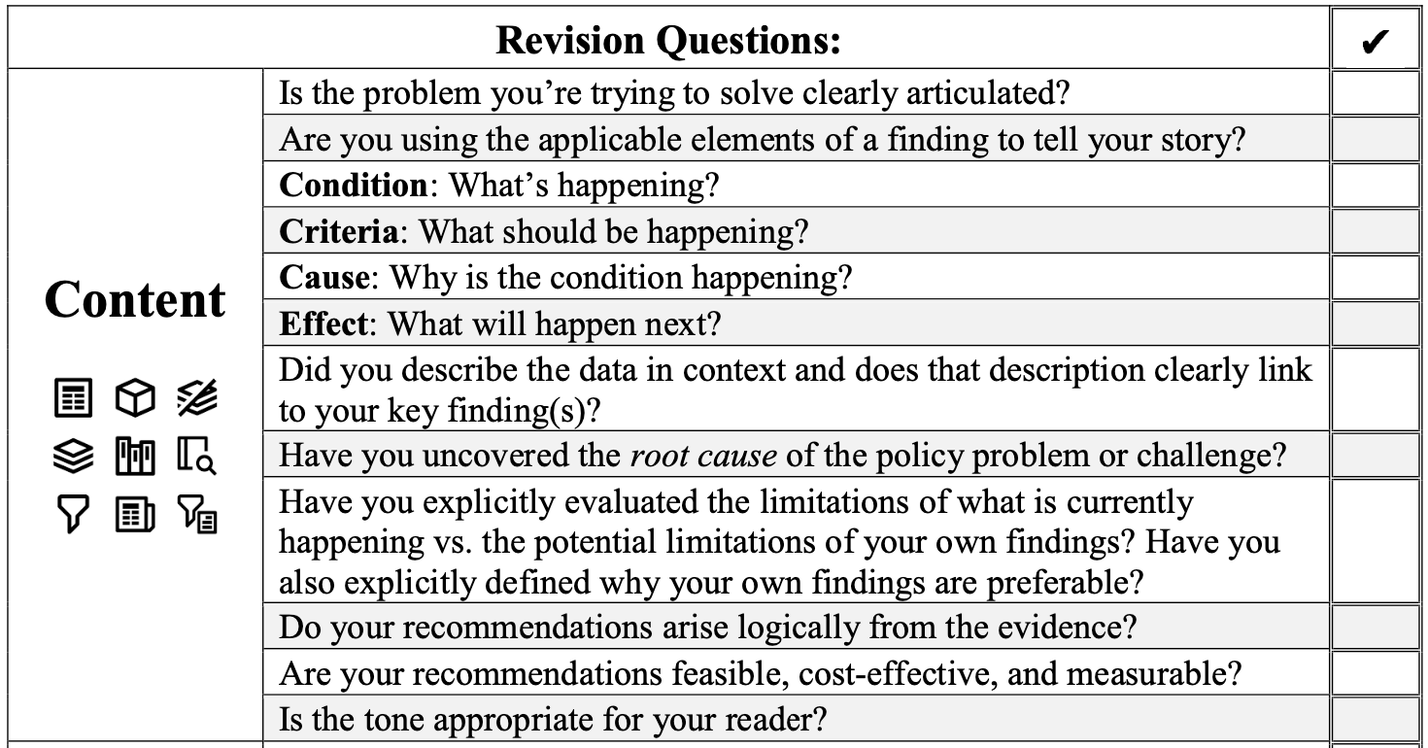
Being Your Own Best Editor 1

Slide 15
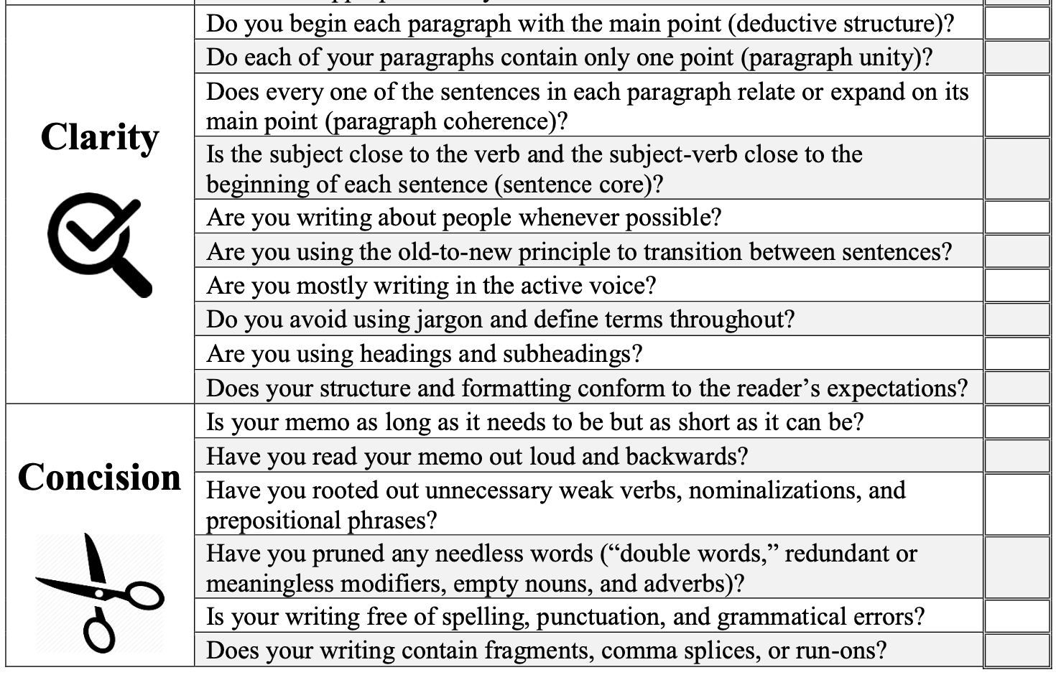
Being Your Own Best Editor 2

