Slide 1
AAPHP Virtual Business Meeting Provider Burnout – A Looming Public Health Crisis Sunday 20 August 2022 4:00 – 6:00 pm CST
COL Damon T. Arnold, MD, MPH, MA, MSTRM (USARNG – Ret.) President of AAPHP
Dennis Garrett, MD Past President of AAPHP

Slide 2
The Harvard Gazette March 31, 2023
Nearly half (49%) of US physicians report burnout in 2023, up slightly from 2022 (45%). Seventy percent have concerns about staffing challenges in 2023, and more than 60% believe that many more qualified healthcare professionals (HCPs) will leave their professions in 2023.
Approximately 50 percent of all respondents reported burnout, with the highest levels among nurses (56 percent) and other clinical staff (54.1 percent) reporting burnout. Intent to leave the job was reported by 28.7 percent of healthcare workers, with 41 percent of nurses, 32.6 percent of non-clinical staff and 31.1 percent of clinical staff reporting the sentiment. The intent to leave was higher for both physicians and nurses in an in-patient setting compared to out-patient settings.

Slide 3
Healthcare Provider Burnout [Medscape Survey]
The prevalence of perceived work overload ranged from 37.1 percent among physicians to 47.4 percent in other clinical staff. And this work overload was significantly associated with both burnout and intent to leave the job.
The US healthcare industry is experiencing a severe shortage of workers at every level—a crisis worsened by the COVID-19 pandemic. The American Hospital Association estimates that the industry will face a shortage of up to 124,000 physicians by 2033.
In total, 53% of physicians said they were burned out—an increase from 47% who said the same in last year's report. Female physicians were also more likely to report feeling burned out than male physicians, at 63% and 46%, respectively.
Notes:
https://www.mckinsey.com/~/media/mckinsey/industries/healthcare%20systems%20and%20services/our%20insights/what%20to%20expect%20in%20us%20healthcare%20in%202023%20and%20beyond/what-to-expect-in-us-healthcare-in-2023-and-beyond.pdf

Slide 4
Charted: Physician burnout continues to rise [17MAR2023]
Over 50% of physicians report feeling burned out and 23% reporting feeling depressed,
Cited Medscape 2023: A physician burnout and depression report included a survey of 9,175 physicians across 29 specialties between 28JUN to 03OCT 2022.

Slide 5
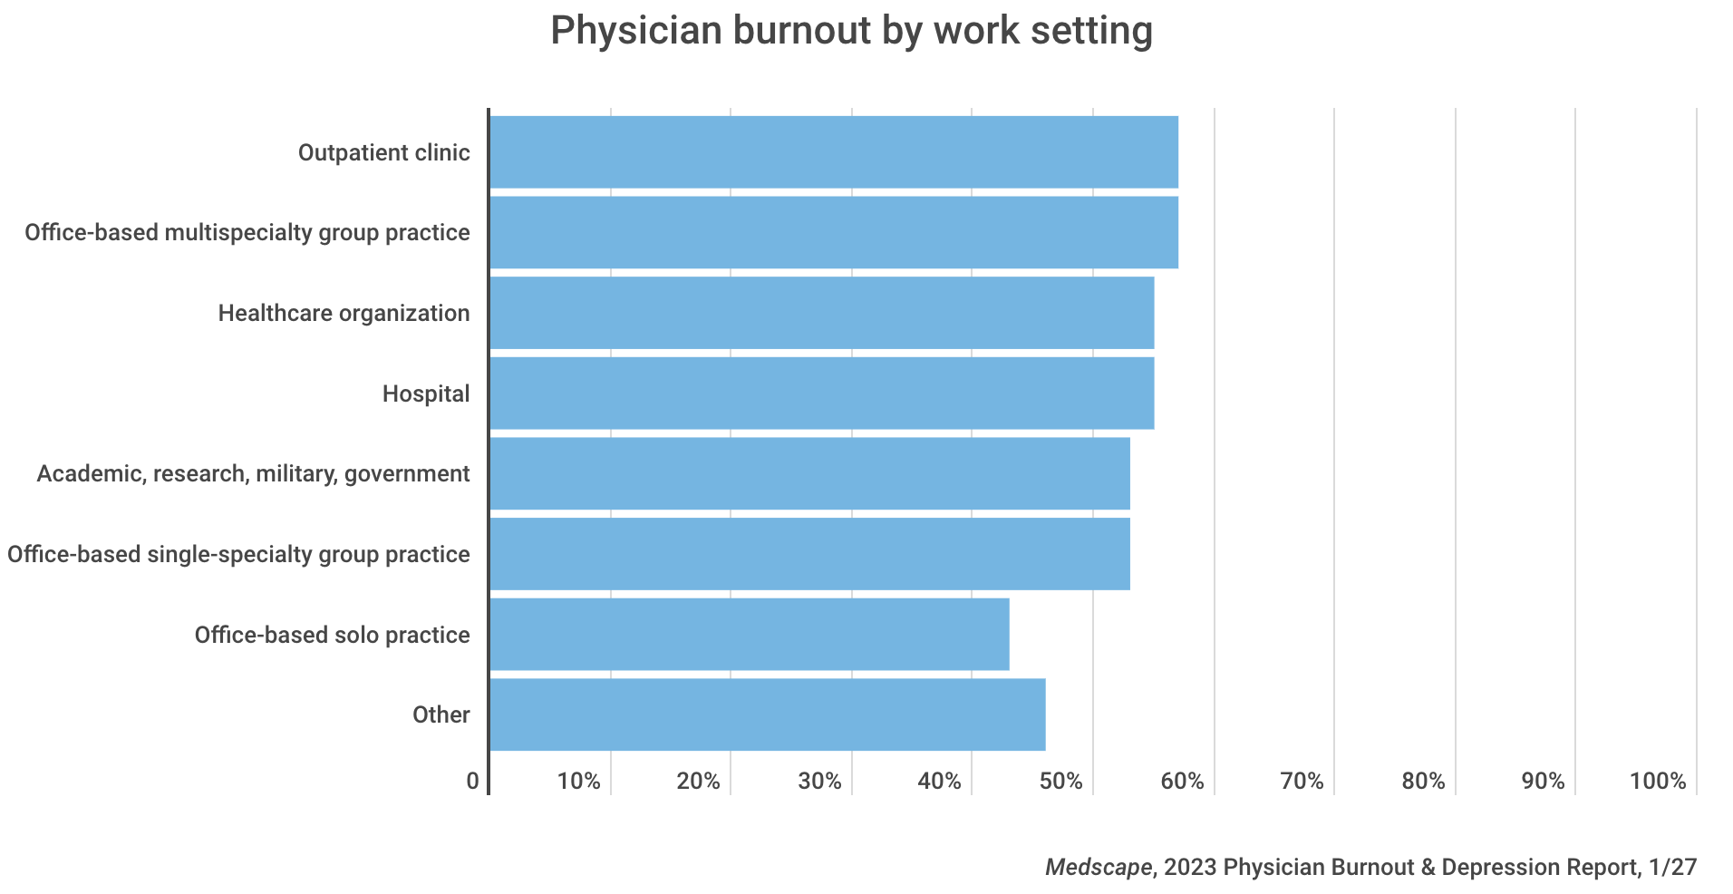
Medscape Survey 1

Slide 6
Medscape Survey 2

Slide 7
BLEED Burnout: Lack of Efficacy + Exhaustion + Depersonalization

Slide 8
Negative elements in a complex work environment
Lack of control over complex work conditions.
Disorganized offices with insufficient staffing and equipment - EHR.
Provider and management confrontations/disagreements/values.
Demanding pace with intense time constraints and pressures.
Persistent and heightened levels of stress and miscommunications.
Insufficient amount and poor quality of sleep.
Poor quality/insufficient (skipped/shortened meals) nutrition.
Mental health impacts contributing to depression and suicidality as well as impaired attention, memory, and executive functioning.
Low levels of medical team cohesion and trust. CLAM N CCC
Notes:
In-group – out-group dynamics

Slide 9
Physician Suicide
Doctors are reported to have the highest suicide rate of any profession—even higher than the military—according to findings presented at the 2018 American Psychiatric Association annual meeting.
Suicide is an occupational hazard of the medical profession.
Doctors with occupational distress may be referred to PHPs (Physician Health Programs).
Notes:
Though students enter medicine with their mental health on par with or better than their peers, they are three times more likely to kill themselves, according to the American Medical Student Association. In some residency programs 75% of interns meet criteria for major depression. (2) Suicide risk increases with untreated mental illness. Physicians who die by suicide are less likely to be receiving mental health care compared with nonphysician suicides. Physicians are more likely to self-medicate for anxiety, depression, and suicidality—with tragic outcomes.
Results from a 7-year investigation of 1,300 physician suicides reveal that doctors (and medical students) die by suicide due to fear of seeking care that would be disclosed on their applications for residency, hospital privileges, and state licensure. Fear of seeking treatment leads to delayed diagnoses thereby increasing anxiety, depression, substance abuse, and suicide. (5)

Slide 10
Violation of physician legal protections as patients
State medical boards exist to protect the health, safety, and welfare of patients through licensing, investigating, and disciplining of impaired physicians. However, medical board mental health questions may not only be violating laws, but also impairing physicians’ access to confidential compassionate health care.
The AMA Code of Medical Ethics upholds the right of confidentiality for all seeking health care.
HIPAA (Health Insurance Portability and Accountability Act) provides data privacy and security provisions to safeguard medical information for all US citizens.
The ADA (Americans with Disabilities Act) of 1990 states: “No covered entity shall discriminate against a qualified individual on the basis of disability in regard to job application procedures, the hiring, advancement, or discharge of employees, employee compensation, job training, and other terms, conditions, and privileges of employment.”
Notes:
Nearly 40 percent of doctors said they’d be reluctant to seek mental health care due to concerns about obtaining or renewing their license to practice, according to a 2017 paper published in Mayo Clinic Proceedings.

Slide 11
Five State Categories based on invasiveness of mental health questions https://www.idealmedicalcare.org/physician-friendly-states-for-mental-health-a-review-of-medical-boards/
Grade A: States with no mental health questions or one or two straightforward current impairment question(s) that do not mention mental health.
13 States: NY, CT, HI, and MI (best – no MH questions); IN, KY, NJ, ME, MD, MA, NV, PA, and WY.
Grade B: States with progressive mental health question(s) linked to current impairment.
12 States: IL, IA, MN, MO, NM, NC, SC, SD, TN, VT, VA, and WI.
Grade C: States with mental health question(s) spanning the last 5 years.
9 States: AZ, CO, ID, ND, OH, OK, OR, TX, and UT.
Grade D: States with “have-you-ever” questions related to mental health, mental health questions beyond 5 years, or a requirement for peer reference on applicant’s mental health.
9 States: AR, CA, GA, KS, LA, MT, NE, NH, and WV.
Grade F: States with highly invasive mental health questions unlinked to current impairment that contain confusing, punitive, or adversarial language.
7 States: AL, AK, DE, FL, MS, RI, and WA.

Slide 12
Alaska 2019 Medical Board Licensing Application
Illness versus Impairment
Hours worked and impairment
Sleep deprivation and impairment
Post-partum Depression
Marriage Counseling Therapy
Exposure to pain, suffering, and death
Health plan participation, medical liability coverage, & hospital privileges.
Notes:
Medical board intervention is always directed at the physician, not the system. But what if the system causes physician impairment? Case in point: Resident physicians are legally forced to work 28-hour shifts (or longer due to unenforced caps). (9) Working just 17 hours is equivalent to the cognitive and psychomotor impairment of a 0.05% blood alcohol content (illegal to drive in Utah and most Western European countries). Working beyond 24 hours is equivalent to a 0.10% blood alcohol content (exceeding the 0.08% legal limit to drive in 49 states). Impairment escalates along a continuum and is noted even at 10 hours. (8) Sleep-deprivation-related cognitive and psychomotor impairment leads to medical mistakes and fatal car accidents after long hospital shifts. (9)

Slide 13
Proactive steps to combat burnout
Decipher the origin and directly address impairment arising from hazardous working conditions (e.g., staffing support, respect and recognition, flex schedules, appropriate work loads and hours).
Provide time and encourage non-punitive and strictly confidential mental health care for physicians.
Short-term professional coaching → quality of life and resilience.
AAPHP
Form positive relationships with good listeners to air your concerns.
Establish improved work-life balances and pursue creative passions.
Reframe the value of your job participation.
Take vacations – you earned them!
Monetary compensation and benefits (protected time off).
Notes:
EHR has not reduced stress and burnout as promised.

Slide 14
“Imagination is more important than knowledge. For knowledge is limited to all we now know and understand, while imagination embraces the entire world, and all there ever will be to know and understand.”
Albert Einstein

Slide 15
Questions? and Charge!

