Slide 1


The Three P’s of Public Health
APHA AC
01 OCT 2015
1630 HRS
Col Damon T. Arnold, M.D., M.P.H., M.A., CMT

Slide 2
EARTH
  Earth’s Axis: 23.5° Tilt One axis rotation: 23h, 56m
  Time taken to orbit Sun: 365d, 6h, 8m (66,700 MPH)
  Diameter (miles): Longitudinal 7,894; Latitudinal 7,923
  Circumference (miles): Equator – 24,885; Poles – 24,796 N 6 BIOMES
  Mass: 5.94 X 10 kg Age: 4.6 billion years
  Equator
  N SUMMER WINTER N
  S S S
TUNDRA
TAIGA
T.D.F.
GRASSLANDS
DESERT
TROPICAL RAIN FOREST
DESERT
GRASSLANDS
T.D.F.
TAIGA
TUNDRA
EARTH
SUN
TROPICAL RAIN FORREST
SUN

Slide 3
Earth’s Composition
  Surface Area:
  Land – 57,392,606 square miles [29.1%]
  Water – 139,543,870 square miles [70.9%]
  Water Volume: 312,000,000 miles³
  Earth Composition: Iron [34.6%]; O₂ [29.5%]; Silicon [15.2%]
  Magnesium [12.7%]; Nickel [2.4%]; Sulfur [1.9%]; Titanium [0.05%]
  LAYER/[thickness (miles)]:
    Crust [0 - 25]
    Mantle [25 - 1,750] Core Temp
    Core [1750 – 3,967] 13,046° F
    Outer Core
    Inner Core
EARTH
Notes:
Crust: Oxygen is the most abundant element in the crust; the Earth’s core temperature is hotter than the Sun’s surface

Slide 4
Time Zones
TIME ZONES Pacific Islands
180° W International Date Line 180° E
  0 HR 2400 HR
  Enters current day Midnight Starts next day
  Earlier W 90° 90° E Later
  Noon
  Direction of Time
  [ ] 1200 HR
  Greenwich, England
  0° Longitudinal Line (Meridian)
Notes:
At 1200 Noon in Greenwich, England, the Sun is directly above – reminiscent of the Compass? Greenwich Mean Time (a.k.a., Coordinated Universal Time).

Slide 5
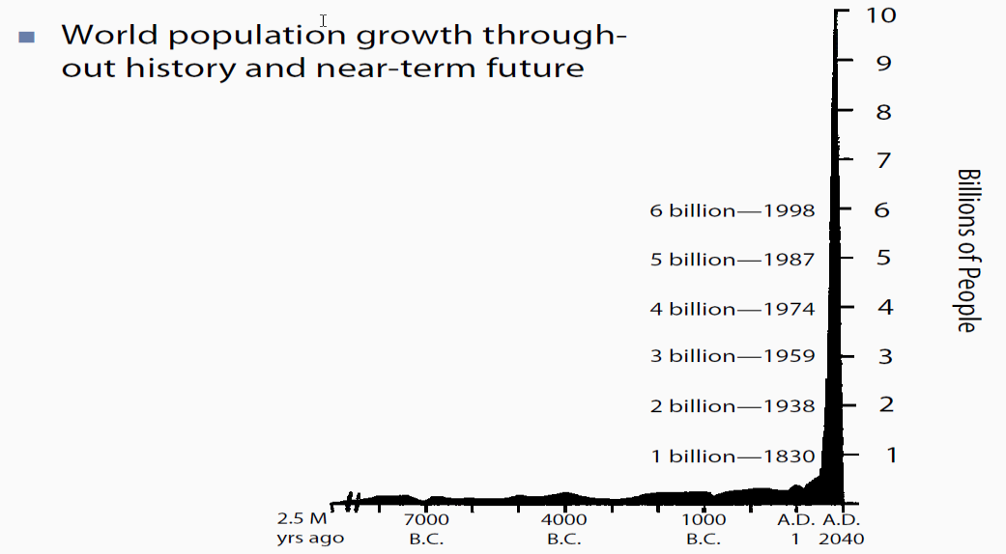
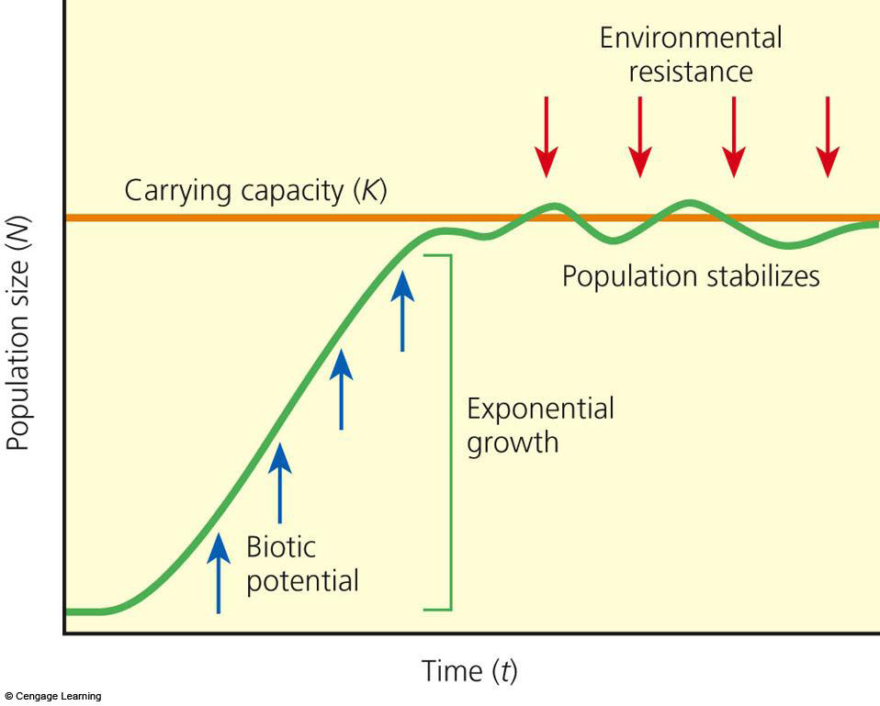
Global Population Growth
S and J Curves

Slide 6
POPULATION SIZE
Population Size Dynamics
Immigration
Births
Older Adults
15–59 y/o
15–59 y/o
Children
Older Adults
GAINS
Children
Deaths
Emigration
Losses

Slide 7
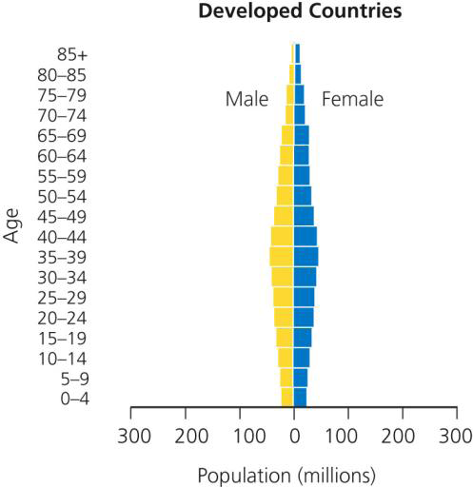
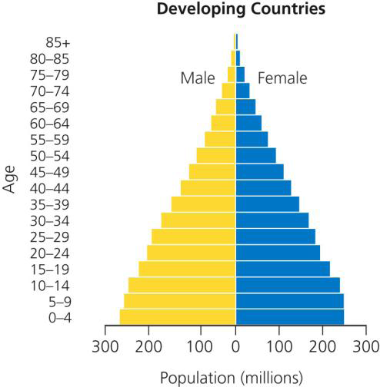
Population Distribution Comparisons

Slide 8
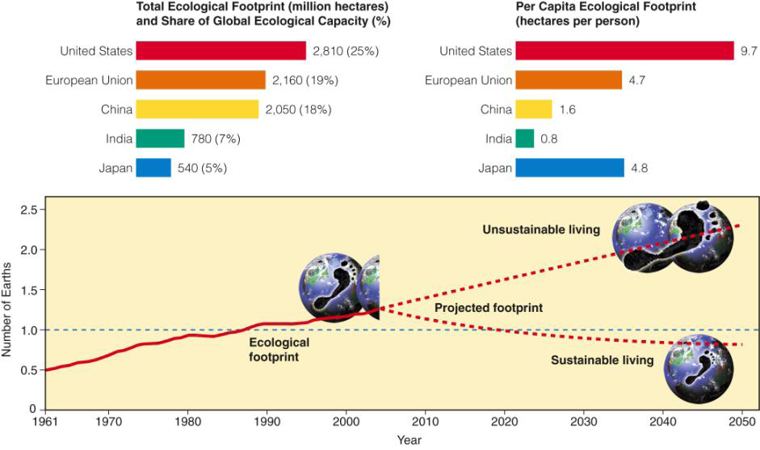
The Ecological Footprint

Slide 9

Environmental Toxicology

Slide 10
Toxicology
Toxicology
Epidemiology
Pathology
Pharmacology
Statistics
Physiology
Chemistry
C
B
R
N
E

Slide 11
Toxicology Focus Areas
Regulatory Toxicology [regulatory matters]
Forensic Toxicology [medico-legal issues]
Clinical Toxicology [manifestations of disease]
Environmental Toxicology [ecosystem affects]
Reproductive Toxicology [reproductive affects]
Developmental Toxicology [teratogens, etc.]

Slide 12
Effects of Chemical Mixture Interactions
Additive: effect is equal to their individual effects added together. 2 + 2 = 4
Synergistic: the combined effect of exposure to two or more chemicals is greater than the sum of their individual effects. 3 + 7 = 80
Antagonistic: two chemicals when administered together interfere with each other’s actions or one interferes with the actions of the other, e.g., Calcium blocking Tetracycline absorption. 2 + 2 = 1
Potentiation: a non-toxic chemical causes a toxic chemical to become more toxic or more active (e.g., adjuvants). 0 + 2 = 7
Coalitive: several agents that have no known toxic effects interact to produce a toxic effect. 0 + 0 + 0 = 8

Slide 13
The Mouth and Chronic Disease
  Smoking Over-Eating Poisons
  Illegal Drugs Medication Misuse ETOH
  Common Portal = The Mouth
  Diabetes Hepatitis CVD PVD
  Cancer Obesity FASD

Slide 14
Environmental and Workplace Agent Exposure
Environmental and Occupational Engineering Controls
[Elimination / Containment / Substitution]
Public Health and Administrative Controls
[BEIACGIHTLV PELOSHA RELNIOSH]
Community Design and Personal Protective Equipment [PPE]
Containment System / Perimeter / P.P.E. Penetration [Breach]
Exposure to the Agent Biological Monitoring and Surveillance
1⁰ 2⁰ and 3⁰ Prevention Injury, Illness and Disease
[Acute and Chronic Forms]

Slide 15
One late night on Halloween, while studying for an exam …
BEIACGIHTLV PELOSHARELNIOSH
NOT AGAIN!!
BAT PORN !
Censored

Slide 16
Environmental Carcinogens
1. developed countries (cigarette smoking, asbestos exposure and high-fat diets)
2. developing countries (food preservatives, viral infection and fungal toxins)
3. Hereditary factors
4. Pathogens: [e.g., Viruses (HEP B, HEP C, HPV]
5. Oxidative damage to cells
6. Carcinogens

Slide 17
Factors Affecting Environmental Policy
Environmental Policy
Economic
Cultural
Scientific
Political
J-E-L

Slide 18
Principles of Environmental Policy Development
Guiding principles and philosophies may act to aid formal and informal policy actors, policy researchers and policy analysts in creating policies.
  The precautionary principle
  Environmental justice
  Environmental sustainability
  The polluter-pays principle
  The level of acceptable risk must be determined for hazards that potentially threaten human and environmental health.
  R = TVC

Slide 19
Interplay between the Evaluation Process and Policy Development
Hypothesis
Scientific Data
Scientific Evidence} Environmental Data
Observational Data
Synthesizing Process} Model
Risk Assessment
Politics
Value {Decision-Making Process}
Costs
Ethics
Policy

Slide 20
The Policy Cycle Stages
Agenda
Setting
Policy
Establishment
Policy
Implementation
Policy
Assessment
(environmental Objectives)
Policy Definition
Formulation
Reformulation

Slide 21
Toxic Substances Control Act [TSCA]
Enacted in 1976
EPA authorized to require reporting, record keeping and testing requirements, and restrictions relating to chemical substances and/or mixtures.
Food, pharmaceuticals, cosmetics, and pesticides are not included.
~ 83,000 chemicals are included

Slide 22
Environmental Impact Assessment [EIA]
EIA: any change to the environment, whether adverse or beneficial, wholly or partially resulting from an organization’s activities, products, or services.
An EIA seeks abatement measures for pollution before it is produced.
Procedures for control of pollution should be feasible and cost effective. (e.g., housing complexes with catch basins to prevent runoff into the ocean)

Slide 23
Health Impact Assessment [HIA]
HIA: a method for describing and estimating the effects that a proposed project or policy may have on the health of a population.
There are six stages for the completion of an HIA. Bulletin of the W.H.O., 2003;81:391-398

Slide 24
Case Studies:
Environmental Policies To Protect Human Health
The 2009-2014 EPA Strategic Plan (c/w the Government Performance and Results Act of 1993)
Protection of the Arctic and Antarctic Environments
Policy Reform in South Africa [National Water Act, 1998]
Environmental Policies in Economies in Transition
Control of Pollution across International Boundaries [N.Y. Convention Act, 1992 and Kyoto Protocol, 1997 – GHGs]
Industrialization of Rural China [Rapid Industrialization]
Protecting the Rights of Children and Special and Vulnerable Populations [Epidemiologic Transition]
The Built Environment

Slide 25
The 2009-2014 EPA Strategic Plan
Reduction of Greenhouse Gas (GHG) Emissions
Sustainable Agriculture
Impacts of Global Climate Change
Contaminants
Import Safety
Improving Program Implementation in Indian Country
Enforcement/Compliance Measurement approach
Research Strategic Directions and Targets
Environmental Indicators, Monitoring, and Related Information

Slide 26
U.S. Agencies Responsible for Environmental Regulation
US Environmental Protection Agency [EPA]
National Institute for Occupational Safety and Health [NIOSH]
Agency for Toxic Substances and Disease Registry [ATSDR]
National Institute of Environmental Health Sciences [NIEHS]
- One of the 27 Institutes and Centers of the National
Institutes of Health [NIH] which is an HHS component.
- Located in Research Triangle Park between Raleigh,
Durham, and Chapel Hill [North Carolina]
- Home of the National Toxicology Program [NTP]

Slide 27
Other Country and Global Environmental Regulatory Organizations
European Union [EU]
  Located in Copenhagen, Demark
  32 member countries
  Environmental policy development, adoption, implementation, and evaluation
  Helped to form the United Nations Environment Program [UNEP]
European Environment Agency [EEA]
World Health Organization [WHO]

Slide 28
Major U.S. Environmental Health Laws
Clean Air Act (42 U.S.C. 7401 et seq. [1970])
Clean Water Act (33 U.S.C. 1251 et seq. [1972])
Safe Drinking Water Act (42 U.S.C. 300f et seq. [1974])
National Environmental Policy Act (42 4321 et seq. [1969])
Federal Insecticide, Fungicide, and Rodenticide Act (7 U.S.C. 136 et seq. [1996])

Slide 29
Major U.S. Environmental Health Laws
Occupational Safety and Health Act (29 U.S.C. 651
et seq. [1970]) [Created both NIOSH (HHS/CDC) and
OSHA(DOL)]
Endangered Species Act (16 U.S.C. 1531 et seq.
[1973])
Toxic Substances Control Act (15 U.S.C. 2601 et seq. [1976])
Resource Conservation and Recovery Act (42 U.S.C. 6901 et seq. [1976])

Slide 30
CERCLA - ATSDR - SARA
Comprehensive Environmental Response, Compensation, and Liability Act [CERCLA (aka., Superfund Law)] (42 U.S.C. 9601 et seq. [1980]) [Created the Agency for Toxic Substances and Disease Registry [ATSDR] opened in 1985, it represents the National public health agency for chemical safety. Under CERCLA, ATSDR’s work falls into 4 Functional areas:
  Protecting the public from toxic exposures
  Increasing Knowledge about toxic substances
  Delivering health education about toxic chemicals
  Maintaining health registries
In 1986, Congress passed the Superfund Amendments and Reauthorization Act (SARA) which provides a more complete accounting of toxic chemicals and releases.

Slide 31
Environmental Advocacy Groups
Greenpeace
National Resources Defense Council
National Wildlife Federation
The Nature Conservancy
Sierra Club
Union of Concerned Scientists

Slide 32

Questions ??

